Slide 1



Charitable
to help you help others.
Veda Ashok, Bridget O’Connor, Sam Gibson, Rachel Nguyen, Krysten Tachiyama
Mentors: Dr. Johnson and Dr. Dionisio

Slide 2
What We Do
We are a Web Application…
that Centralizes Charitable Organizations and Activities,
provides a Social Media Platform to connect Charitable users,
and are non-profit (we are free!)

Slide 3
Project Goals
Make getting involved with your community easier.
Make learning about new causes and organizations easier.
Encourage long-term involvement for causes you are passionate about.
Encourage involvement and collaboration for good causes.

Slide 4
Project Justification
At Charitable, we…
…value service (Thank you, LMU)
01
…are passionate about bettering our communities
02
…want to create an easy-to-use platform that motivates people to give back.
03
…aim to foster a Charitable™ community
04
After a year of earthquakes, wildfires, social unrest, political unrest, and of course, a global pandemic, we wanted to create a community that is passionate about giving back. Charitable is here to help you help others.

Slide 5
Frontend Development
React
Next.js
Vercel
Material UI

Slide 6
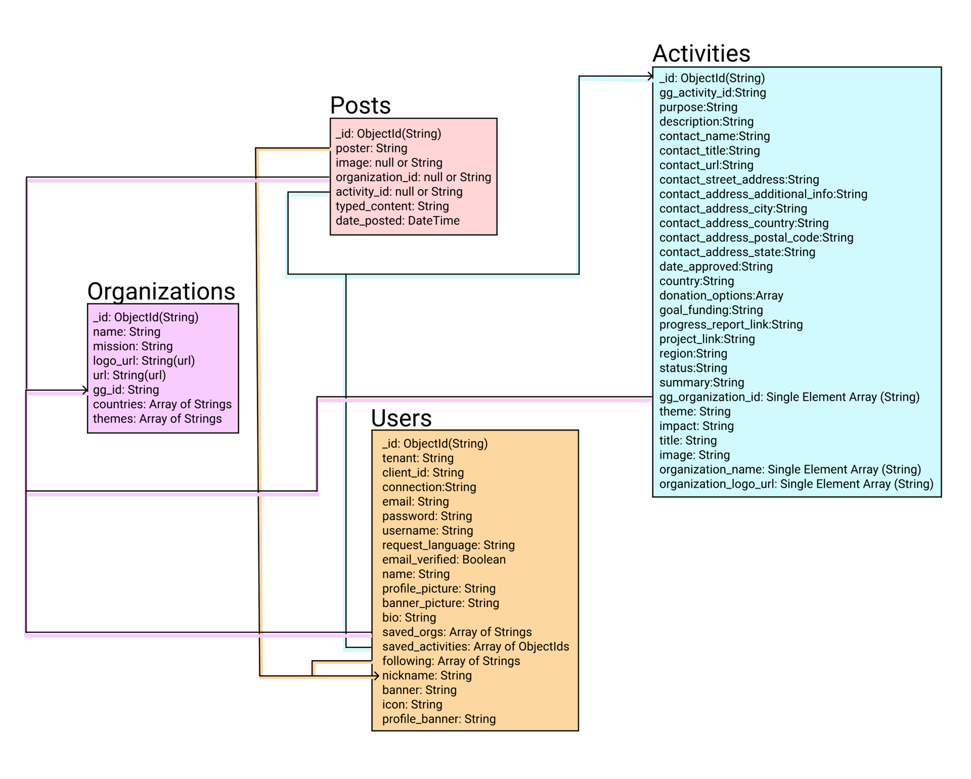
Backend Development

Slide 7
Third Party Services
GlobalGiving
Auth0
Mongo Atlas
Cloudinary

Slide 8
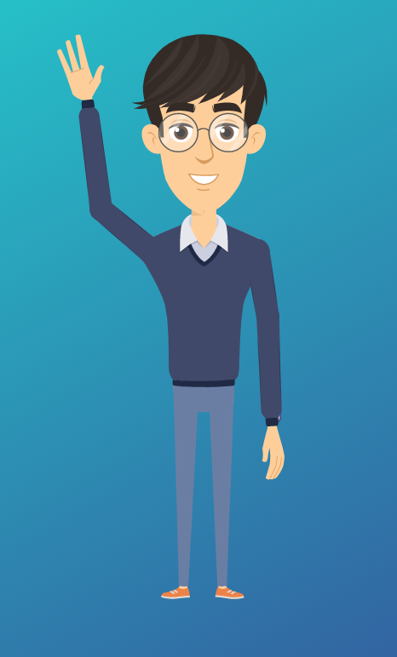
Timmy’s Story
Hi!
I am 26, I live in Seattle, WA, and I am passionate about saving our planet.
I’m Timmy Chu.
Charitable makes it easy to research organizations and projects that I can get involved in!

Slide 9
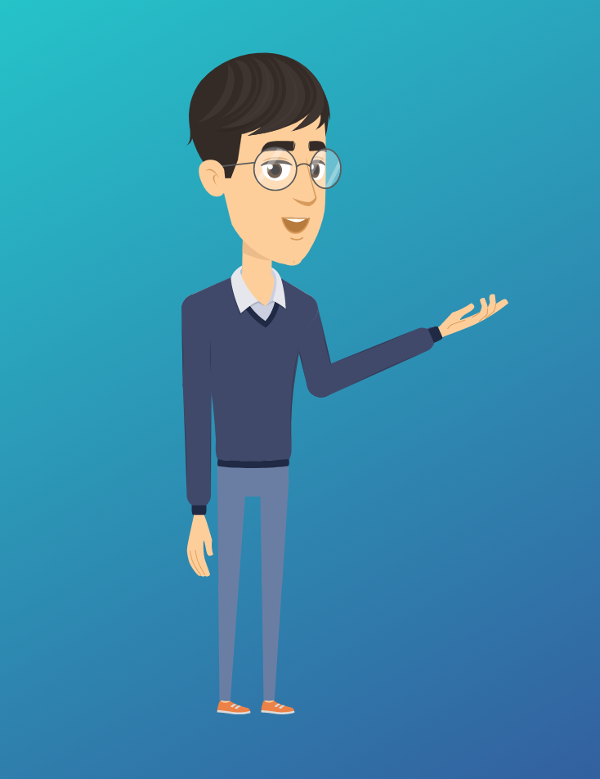
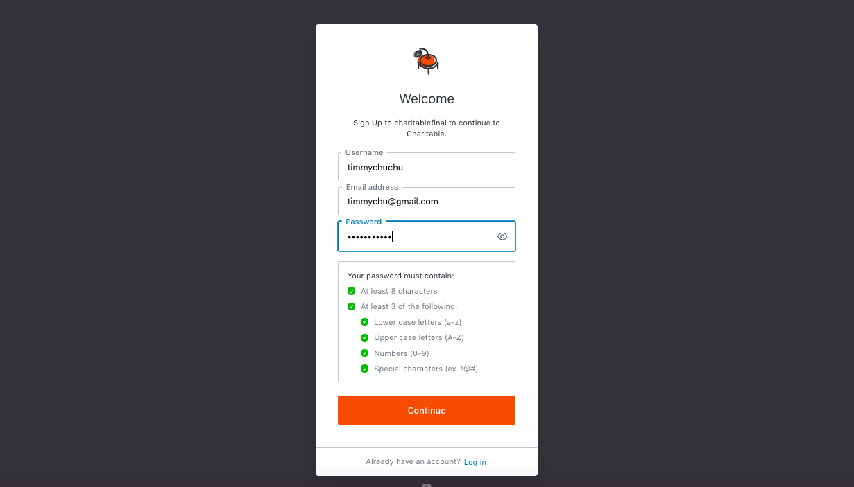
First, I sign up with Charitable on their sign-up page.

Slide 10
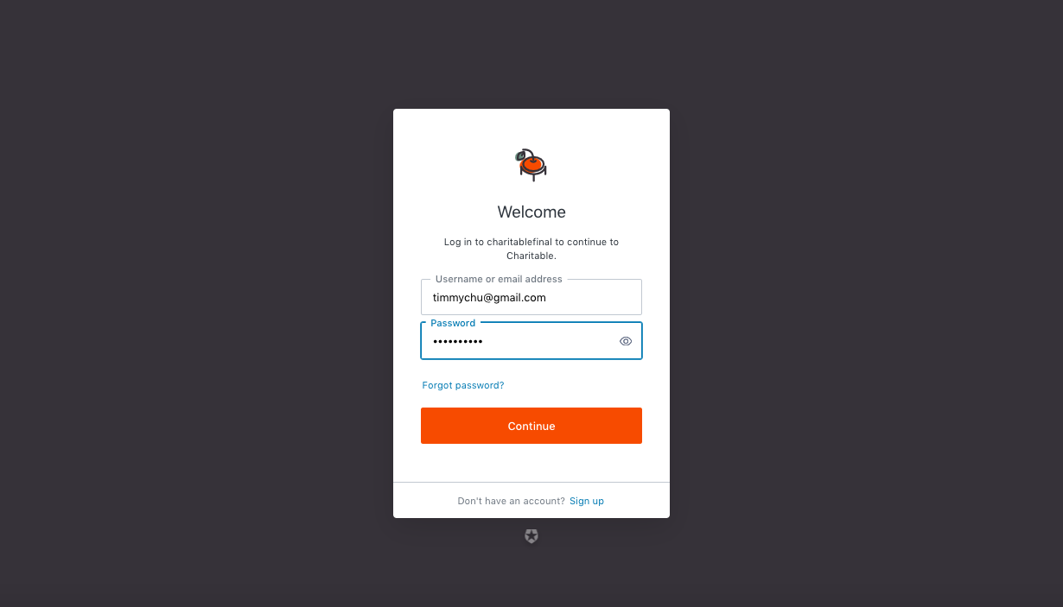
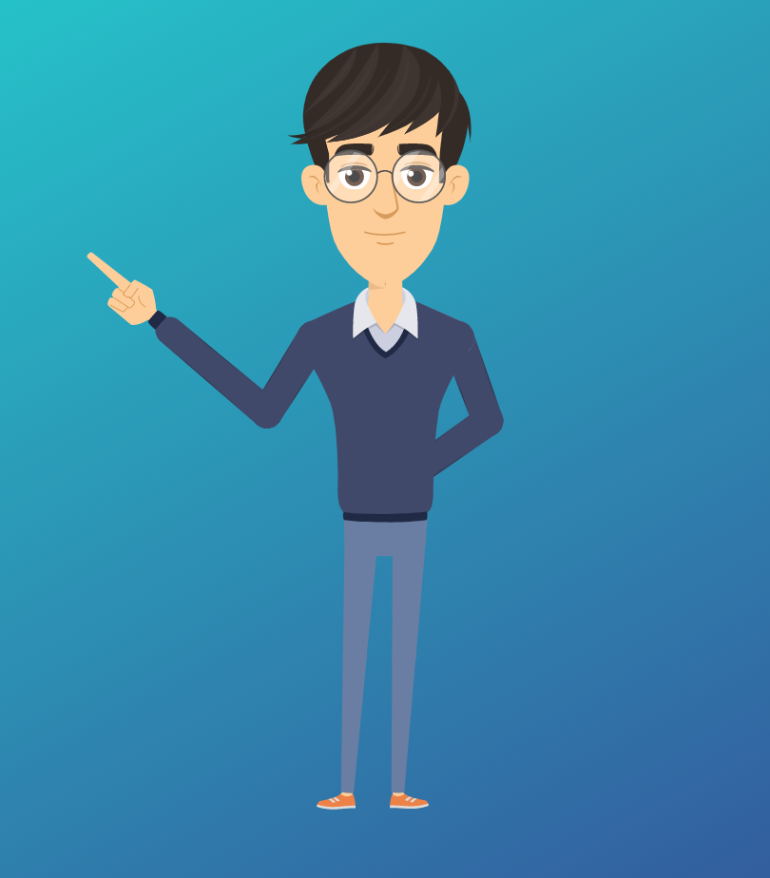
Once I verify my email, I login to my new account…

Slide 11
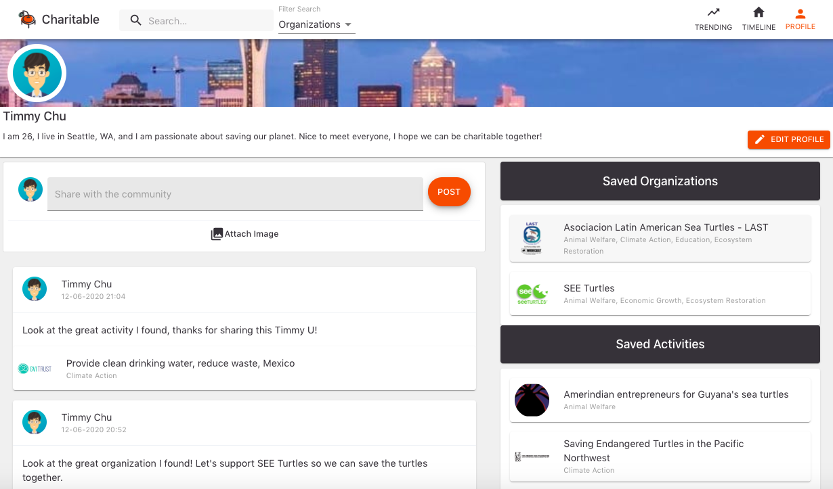

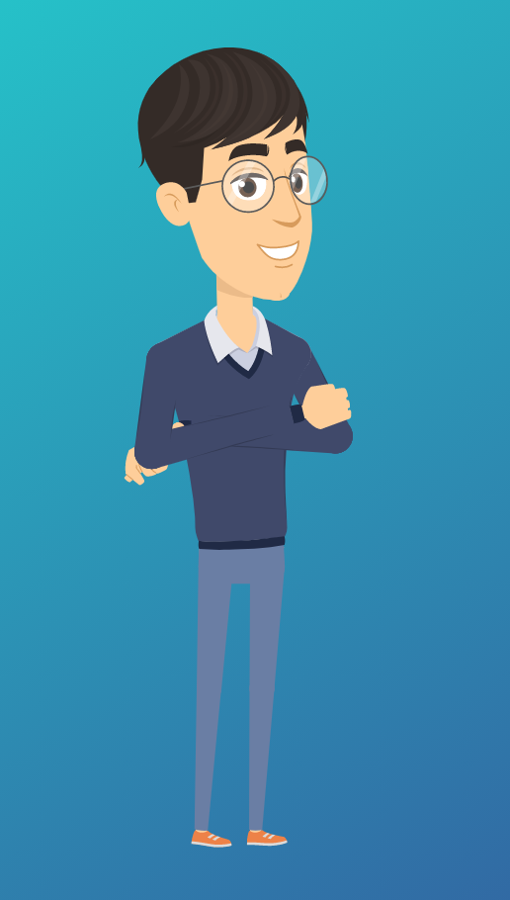
…then, I edit and setup my profile. I even made a post!
I can also search for organizations related to causes I am interested in and save the ones that I like.

Slide 12
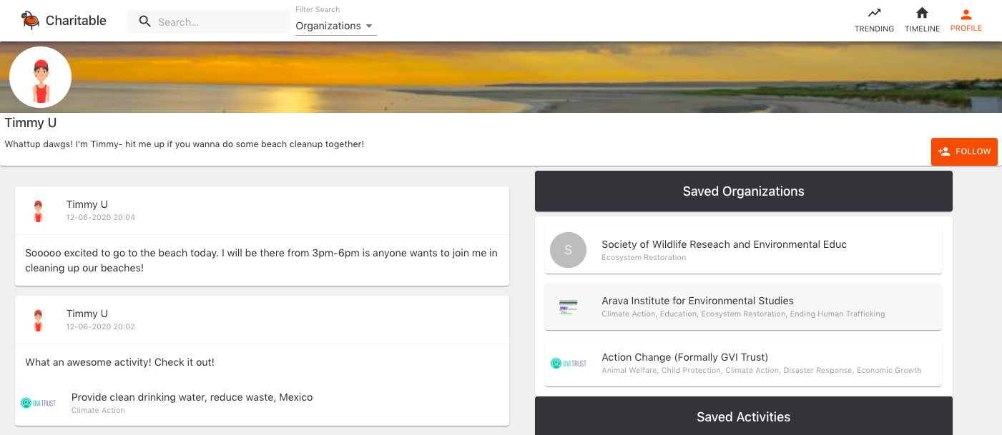
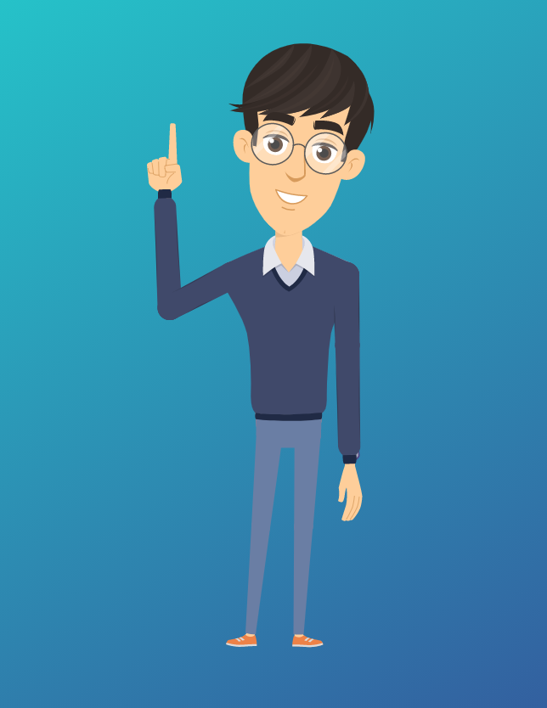
The ‘Follow’ button even lets me connect with other users!

Slide 13
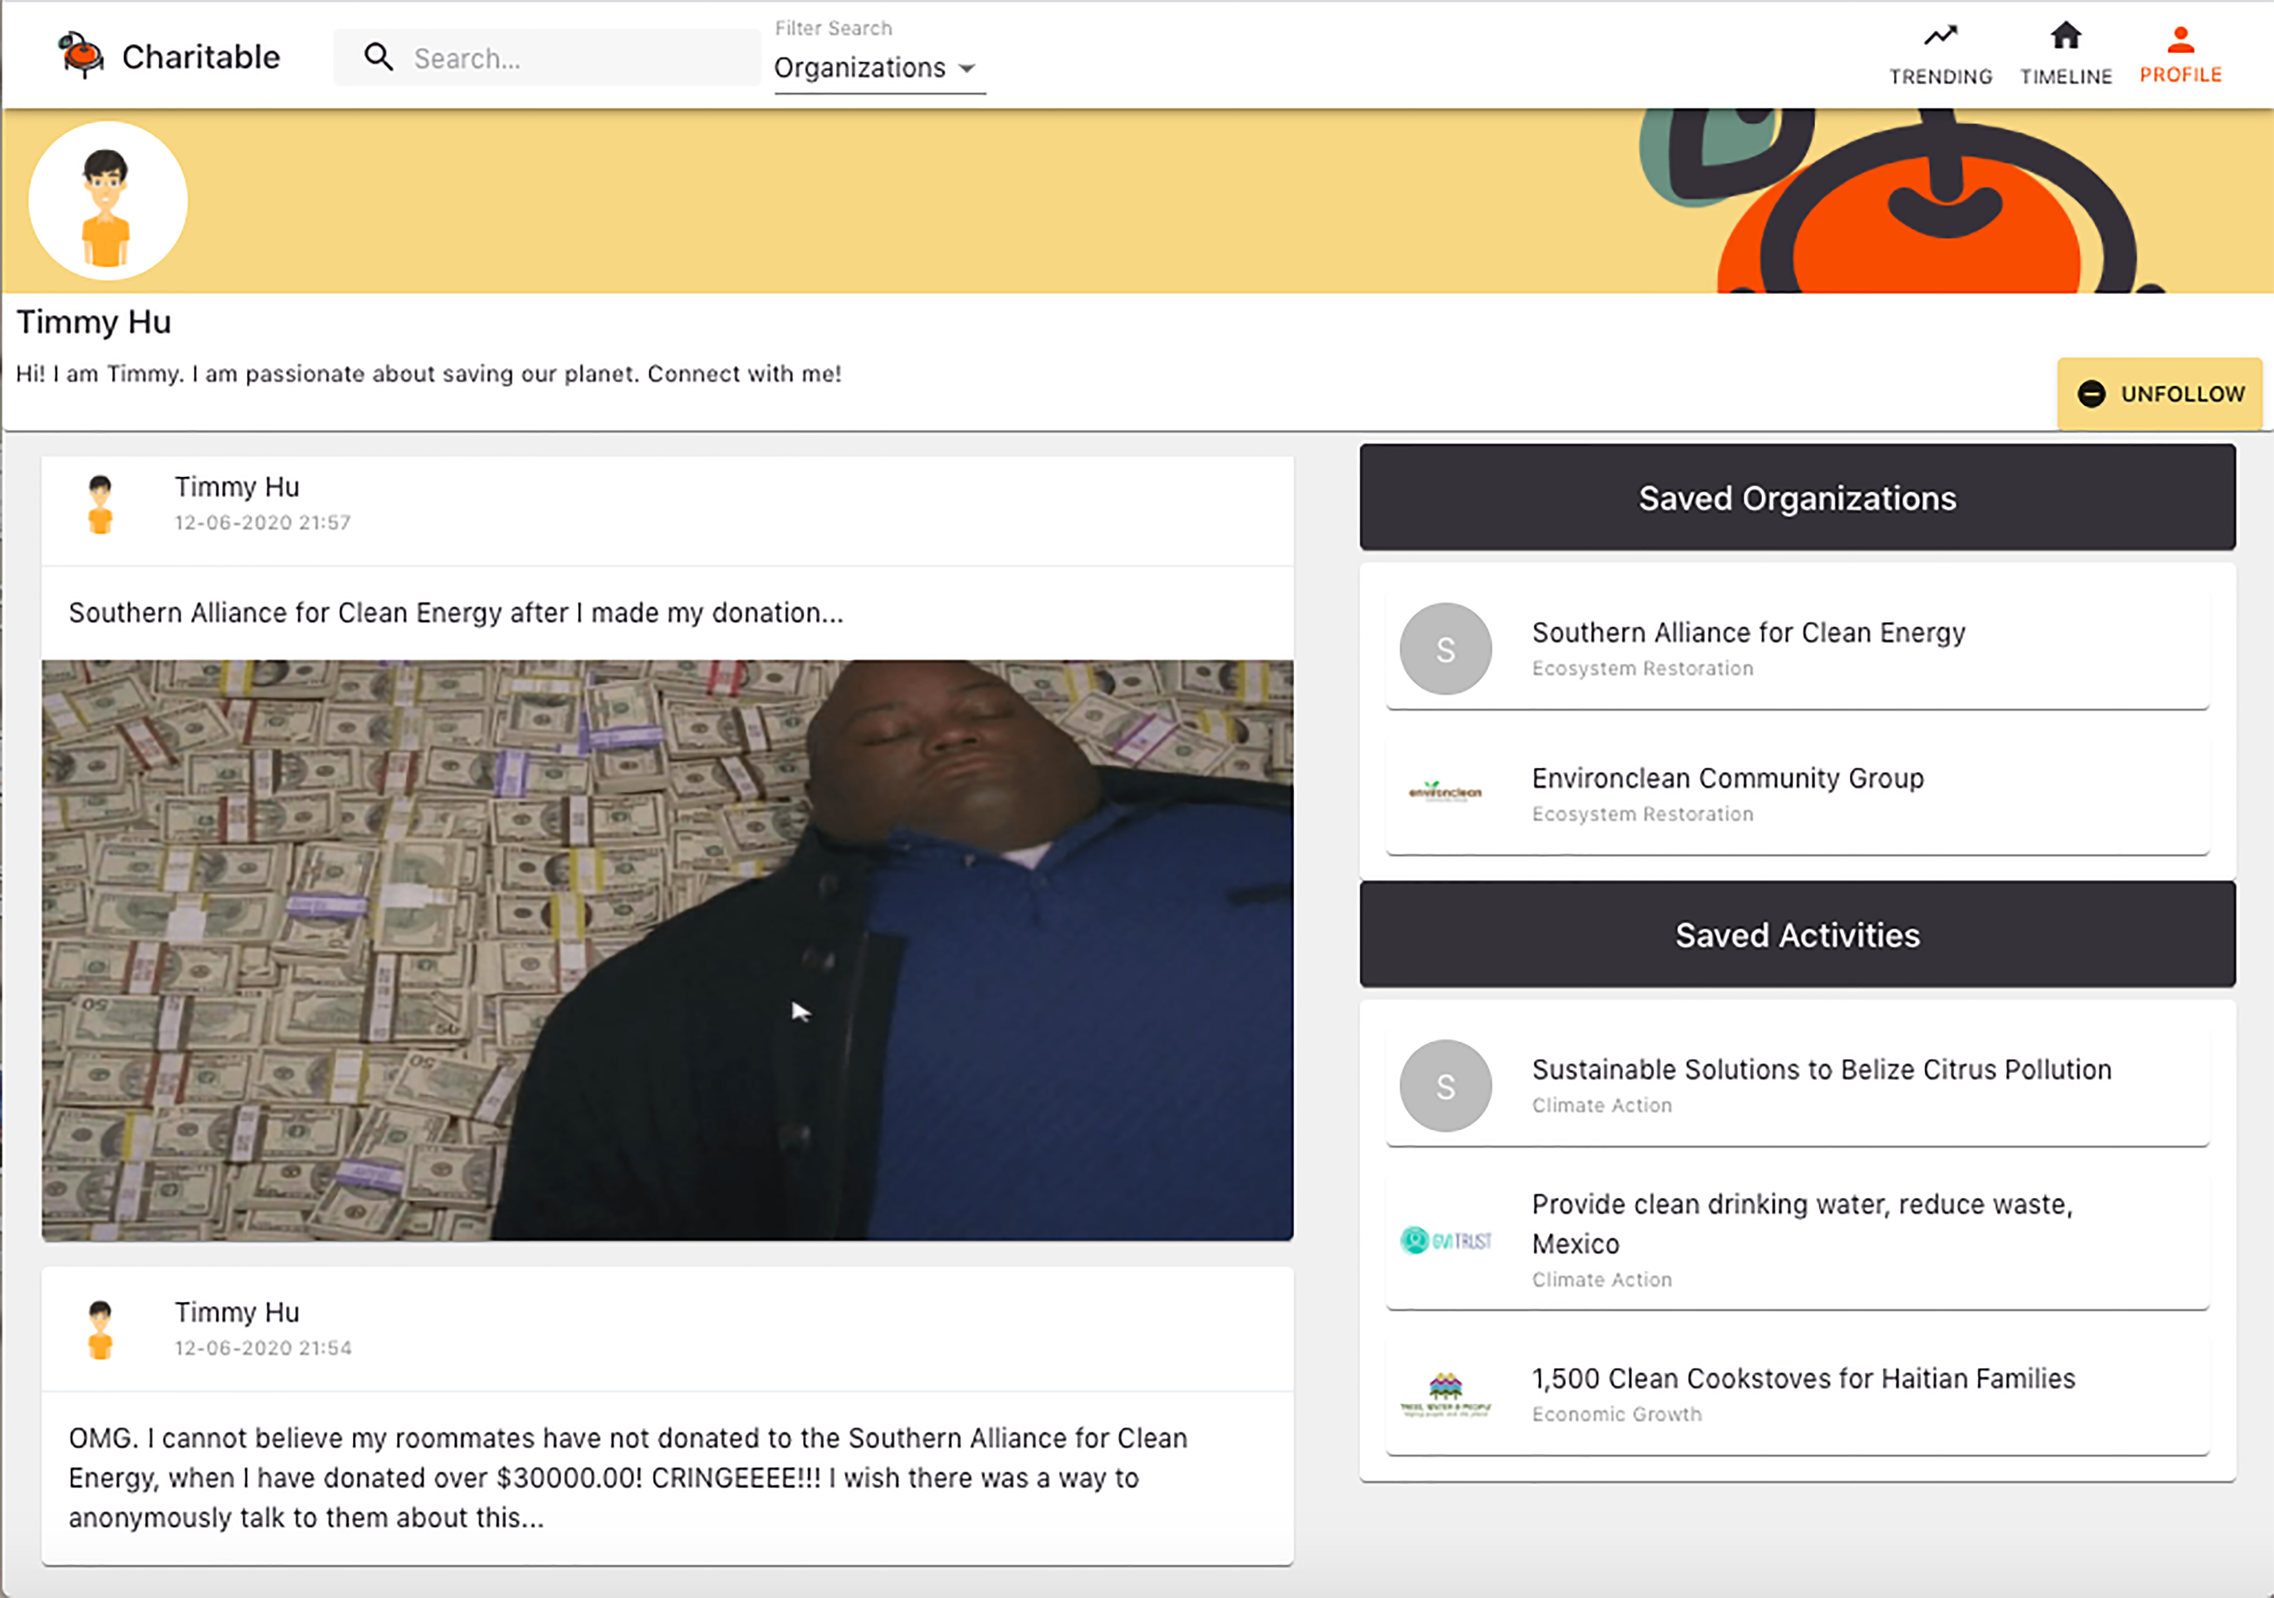
The ‘Unfollow’ button lets me unfollow users that I want to…well…stop following.

Slide 14
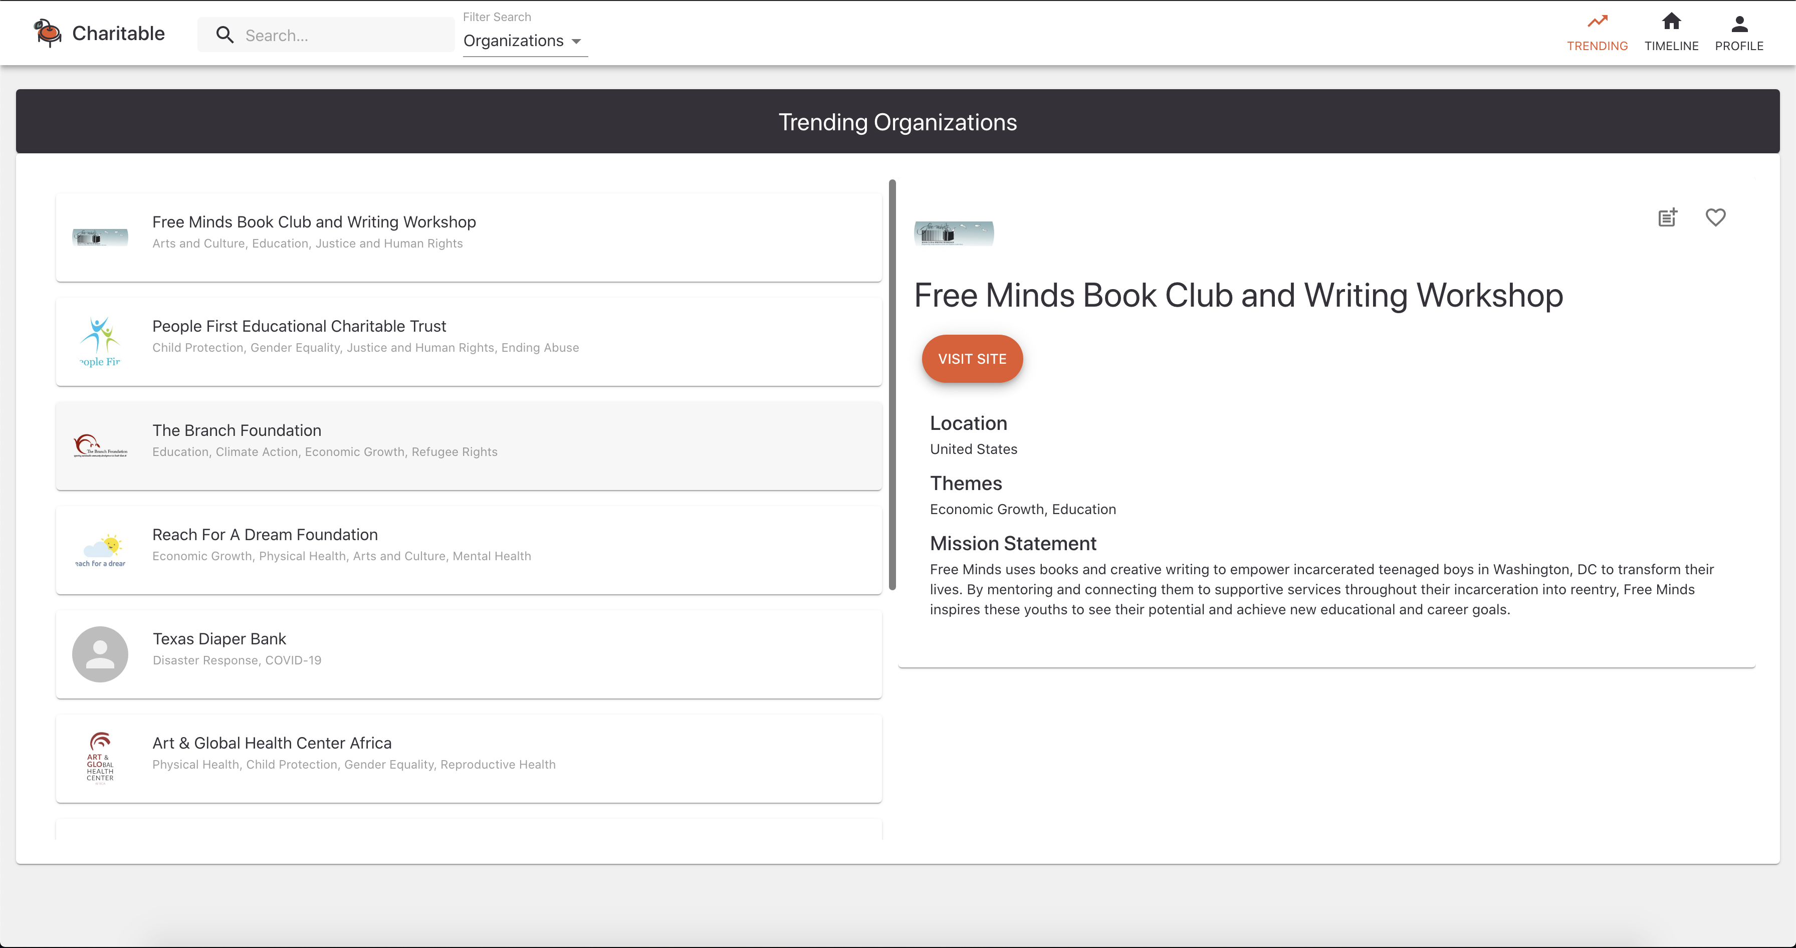
And, I can learn about trending organizations around the world!

Slide 15
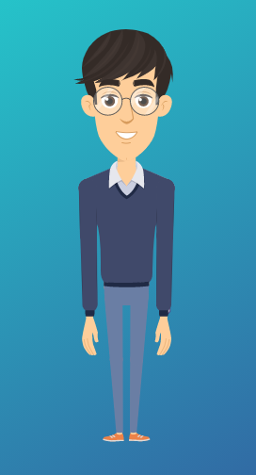
Charitable makes learning about our communities easy. I also get to meet other people
who share my passions and people who teach me more about the world!
I love Charitable because it helps me help others.

Slide 16
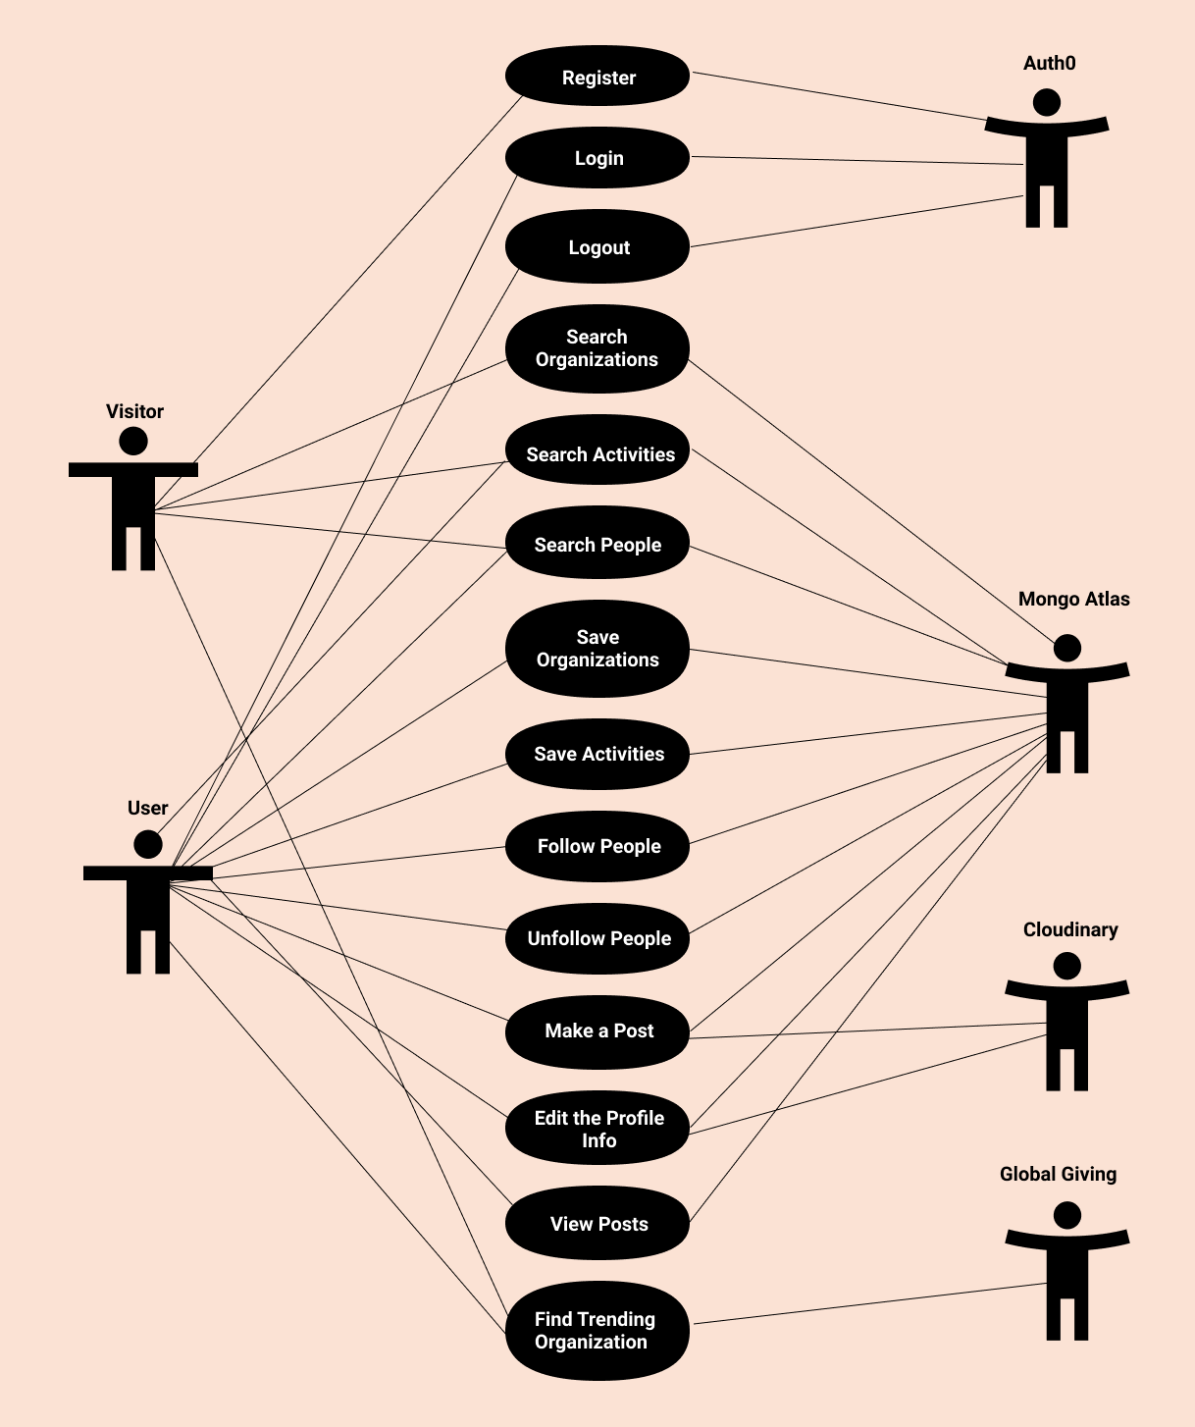
Use-Case Diagram

Slide 17
Demo

Slide 18
4-Panel Progress Report
Accomplishments | Risks
Schedule | Problems/Issues/Concerns
Fully implemented GET calls (Saved organizations and activities, friends that a user is following, search engine).
Fully implemented POST functionalities (Edit profile, creating a post, saving organizations and activities).
Successfully implemented follow/unfollow functionality.
Auth0 still poses risk of locking developers out of their accounts.
If any API we use (MongoDB, GlobalGiving) does down, our applications functionality will not succeed.
TASK | WEEK ESTIMATED | WEEK COMPLETED/ PROJECTED | PROGRESS
Create Mockups of Our Site | Week 01 | Week 01
Build Basic Frontend | Week 03 | Week 03
Obtain and Parse Data | Week 04 | Week 08
Enter Data into Database | Week 05 | Week 08
Set up Signup/Login/Logout | Week 06 | Week 06
Set up GET Calls | Week 07 | Week 12
Set up POST Calls | Week 13 | Week 14
Set up Friend Function | Week 14 | Week 14
Implement Post Ability | Week 14 | Week 14
Integrate | Week 14 | Week 14
Test | Week 15 | Week 15
Deploy | Week 15 | Week 15
We need to make new Auth0 accounts every 22 days – user accounts can only last for 22 days.
Completed
On Track
Behind
Not Started

Slide 19
Thank You
We are looking forward to making your day more Charitable.

